Slide 1


Post Traumatic Stress Disorder and Co-Occurrence of Traumatic Brain Injury
Scott Katzka, LPC, NCC
Team Leader
Gregory Asgaard, Ph.D.
Clinical Psychologist

Slide 2
Talking Points
Vet Center
PTSD and TBI
Helping Tips
Testimonial
Questions and Answers

Slide 3
Vet Center History
Established by Congress in 1979.
Originally for Vietnam Era vets.
Service now extended to all war zone vets and sexual harassment/assault victims of any era.
Goal is to provide a broad range of counseling, outreach and referral services, to help vets make a satisfying post-war readjustment to civilian life.

Slide 4
Mission
Currently there are over 300 Vet Centers nationwide whose mission is to serve Veterans and there families by providing a continuum of quality care that adds value for Veterans, families, and communities. Care includes professional readjustment counseling, community education, outreach to special populations, and brokering of services with community agencies. We provide a key link between the Veteran and other services in the United States Department of Veteran Affairs.

Slide 5
What Does the Vet Center Offer?
A safe place to talk
Confidentiality
Counselors who have experienced combat themselves
Flexibility of hours
Individual counseling
Group counseling
Marital and family counseling
Sexual trauma counseling
Bereavement counseling
Liaison with the VA
Drug and alcohol counseling (referral)
Benefits Assistance (referral)
Employment guidance (referral)

Slide 6
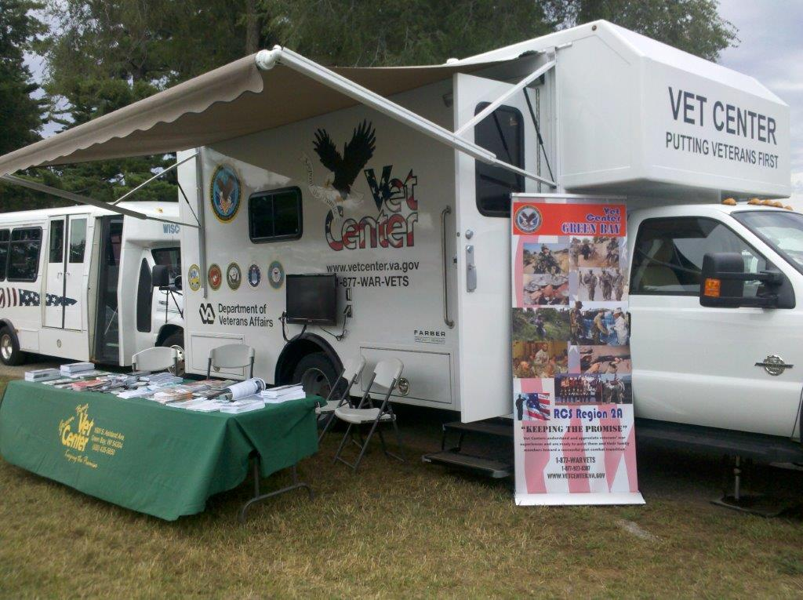
Mobile Vet Center

Slide 7
Wisconsin Vet Centers
Madison Vet Center 706 Williamson St Madison (1980)
Milwaukee Vet Center 7910 N 76th St Milwaukee (1980)
Green Bay Vet Center 1600 S Ashland Ave Green Bay (2009)
Lacrosse Vet Center 20 Copeland Ave Lacrosse (2010)
Wausau Outstation 605 S 24th Ave Suite 24 Wausau (2011)
Vet Center Hours: Monday - Thursday 8:00 A.M. to 7:30 P.M. Friday 8:00 A.M. to 4:30 P.M. (Weekend and other times by appointment)

Slide 8
The Vet Center prides itself on confidentiality and the fact that many of the counselors are combat veterans themselves.

Slide 9
The Vet Center has flexible hours.

Slide 10
The Vet Center is
FREE!!!

Slide 11
Operational stress
Living in a world of constant threat
False alarms
Remorse for decisions or actions (e.g., taking lives)
Separation from loved ones
Brotherhood
Trained to be self-sufficient and resilient

Slide 12
Post Traumatic Stress Disorder (PTSD)
Being in warzone is associated with 50% prevalence of symptoms of PTSD, while 25% develop disorder
Exposure to actual or threatened death, serious injury, or sexual violence
Memories or thoughts that return during daytime or in nightmares
Avoidance of triggers or reminders of trauma
Notes:
Symptoms begin 3 months after trauma, but may be delay of years.

Slide 13
PTSD
Altered mood or thoughts
  Feeling detached or withdrawn from others
  Negative beliefs or expectations about oneself, other people, or the world.
Altered levels of arousal and reactivity
  Irritability, angry outbursts, reckless behavior
  Sleep problems (e.g., broken or insomnia)
  Exaggerated startle

Slide 14
PTSD
Moral or “Soul” Injury
  Acts that violate moral beliefs and expectations (Maguen and Litz, 2012)
  Guilt and shame
  Most significant predictor of suicide is combat-related guilt (Hendin and Haas, 1991)
Conceptualized as neo-conditioning model
Appearance depends on pre-existing characteristics

Slide 15
Physical Impact of Stress
“…evolution prefers short term survival at the expense of long term function.”
Many veterans live in constant stat of fight, flight, or freeze, with little rest in between
Rational thought and reason are colored by strong emotional response
Results in hypertension, memory and learning impairment, ulcers, sexual problems, and weak immune system.

Slide 16
Co-occurring conditions
Clinical depression
Suicidal behavior and/or thoughts
  In 2009, the Wisconsin VA reported that veteran’s make-up 8% of state’s population
  Veteran’s account for 21% of suicides
Between 40-60% of those who die by suicide are intoxicated at the time of death

Slide 17
SELF-MEDICATION

Slide 18
Co-occurring conditions
In autopsy studies, 89% alcohol-dependent suicides demonstrated history of other psychiatric illness (Foster et al., 1997)
Research mixed because of overlapping symptoms clusters

Slide 19
PTSD and mTBI
mTBI appears to increase risk for PTSD.
In a large military survey, whereas 16% of troops who sustained a bodily injury indicated PTSD, 44% of those with MTBI screened positive for PTSD (Hoge et al, 2008)
In prior conflicts, approximately 14% - 20% of surviving casualties had a TBI.

Slide 20
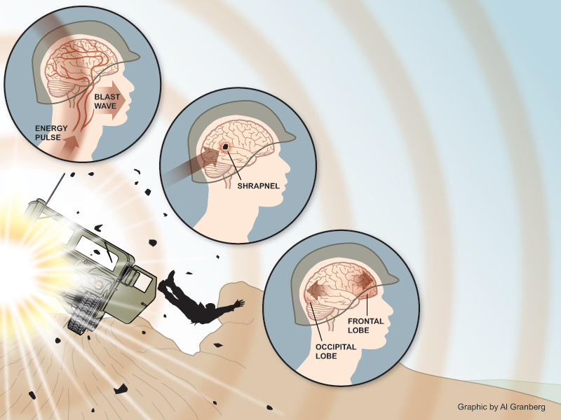
Notes:
Pressure variations from blast pass through brain tissue. Shock waves can aslo cause brain trauma by compressing the chest and abdomen, which transfer the waves kinetic energy through large blood vessels into the brain

Slide 21
Traumatic Brain Injury (TBI)
Severity determined at time of injury
According to DOD, most cases are mild.
Return to work in 10 days with rest.
Common Symptoms Immediately After Injury
  Being Dazed, confused, or "seeing stars"
  Not remembering the injury
  Losing consciousness (being knocked out)

Slide 22
Classifications of injuries
Concussion/Mild TBI is characterized by the following: Confused or disoriented state <24 hours; or loss of consciousness for up to 30 minutes; or memory loss lasting less than 24 hours. A brain scan is not indicated for most patients with a Mild TBI. If obtained, it is often normal.
Notes:
Moderate is confused or disoriented for more than 24 hours; or loss of consciousness for more than 30 minutes, but less than 24 hours. Severe TBI is confused or disoriented for more than 24 hours or loss of consciousness for more than 24 hours. Penetrating TBI or open head injury is a head injury in which the scalp, scull or dura mater are penetrated.

Slide 23
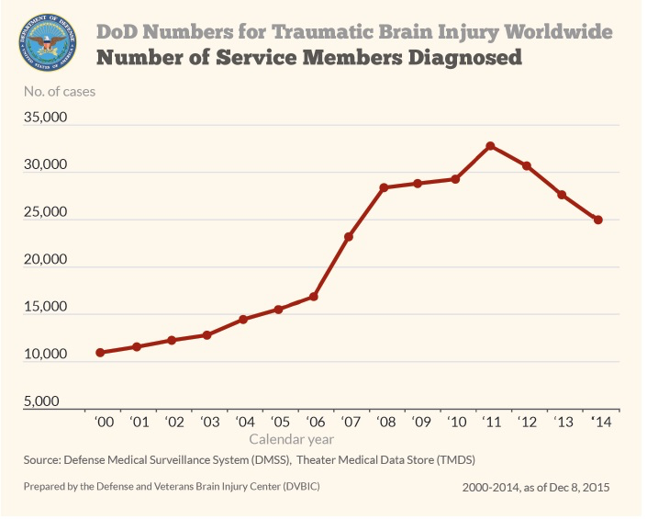

Slide 24
TBI symptoms after injury
Post-concussion syndrome:
  Physical: Headache, dizziness, low energy, sleep disturbance, vision problems
  Cognitive (mental): Memory, attention, judgment, word finding
  Emotional: Depression, anger, worry, character changes
Increased risk with repeated injury
Symptoms overlap with PTSD

Slide 25
Readjustment
“What is crucially important is to realize that the rules of the warzone do not automatically change when service members come home.” (Dr. James Munroe, Boston VA Healthcare System)
No one teaches our veterans how to readjust from a normal response to an extreme, abnormal situation

Slide 26
Veterans Face Challenges with Transitions to:
Home
Work
School
Family

Slide 27
Safety
“I must check the perimeter of the house and each door and window before going back to be” (Vietnam Veteran)
Being in the warzone requires constant vigilance
Combat changes the sense of safety

Slide 28
Trust
“I couldn’t relate to or trust my friends when I got home.” (Afghanistan veteran)
Veterans must adjust their sense of trust in the warzone
Trust is built on performance in combat
Effects at home

Slide 29
Anger, Anxiety, and Depression
“People didn’t understand that I wanted, and needed, to go back. I got angry, and drunk.” (Iraq)
Anger can be useful in a warzone
Strong emotions cause problems at home where a broader range or more complex emotions are needed in relationships.

Slide 30
Decision Making
“Decisions were always black or white, no middle ground.” (Wife of an Iraq veteran)
In a warzone, decisions must be made quickly and clearly
At home, decision making is usually very different

Slide 31
Closeness
“You develop a bond like no other as a civilian because of all you been through together”
Relationships in a warzone can become very intense, very quickly
Relationships are different at home, they need to be sustained over time, not just in crisis

Slide 32
Tips for Helping in crisis
Speak in a calm, matter of fact, and caring voice
Ask for clarification to make sure you heard correctly
Remind the veteran where they are (e.g., home)
Reassure that feelings are not unusual

Slide 33
Things to avoid
Saying “I understand”. Instead, try saying “I’m sorry that you had to experience that” or “sounds intense.”
Negative facial expressions that can be interpreted as hostility or judgmental
Trapping the veteran
Saying “get over it”
Avoid asking specifics about the combat experience

Slide 34
Tips for Getting Veteran’s Help
SCREEN for Substance Use and Psychiatric Illness
Ask directly about suicidal thoughts “are you thinking about killing yourself?”
Limit access to lethal means
Ask for help and assist with this step
Verify to see s/he followed through to receiving help
“I am a lot less withdrawn and numb with a greater range of emotions now (Vietnam)”

Slide 35
TBI
Symptoms improve over time
Effective treatments for PTSD also work well for those with mild TBI
Slowly get back slowly into routine

Slide 36
Every Veteran is Different
No timetable
Become educated about symptoms and treatments
Communicate to understand when they need help
TREAT Substance Abuse and Mental Illness concurrently
Reassure that getting help is not a sign of weakness, but one of strength.

Slide 37
For more information access the Vet Centers website at www.vetcenter.va.gov
Department of Veterans Affairs: www.va.gov
http://www.mirecc.va.gov

