Slide 1
Blue Ribbon Commission – Veteran Opportunity
Welcome
May 4, 2022
Notes:
Good morning and thank you all for joining us here today.
We’re here today to talk about how we’re going to tackle the growing student debt crisis here in Wisconsin.

Slide 2
Housekeeping
Zoom Basics
Roll-Call & Introductions of Commission Members
Meeting Ground Rules
Notes:
This slide lets Task Force members and other attendees know the three topics I will be covering.
WebEx Basics, has a more detailed slide.
Roll-Call & Introductions, slides will not be shared so we can see and meet everyone.
Ask the Attendees, when name is called, respond and tell us where they are from (organization they represent) and their “title or role.”
Meeting Ground Rules, has a more detailed slide with basic ground rules seeking all members to agree to honor.

Slide 3
Zoom Basics
Notes:
Overview of the Button panel at bottom of Screen:
Mute
Video
Participant List
Chat Function – Explain this is how we will take questions during presentations (save them for the end, but ask using this feature as questions arise)
Raise your Hand – Explain how/when we may use this feature.
Dial-in Participants, explain how/when they can ask questions of presenters – Email the Student Debt Email box at StudentDebtTaskForce@dfi.wisconsin.gov (Marko & Cheryl will be monitoring for questions)
Recording of Meetings – let all attendees know meetings are being recorded.

Slide 4
Meeting Ground Rules
Respectful Communication
Active Listening
Attendance and Participation
No Multitasking = Silence Cellphones, Turn-Off Email
Creativity and Open Mindedness
Preparation (Pre-Work)
Notes:
Ask that all participants agree to the Meeting Ground Rules.

Slide 5
Governor’s Task Force Appointments
Department of Veteran Affairs (DVA) Secretary Mary Kolar, U.S. Navy, retired, Co-Chair
Department of Administration (DOA) Secretary-designee Kathy Blumenfeld, Co-Chair
State Sen. Jeff Smith (D-Brunswick)
State Sen. Joan Ballweg (R-Markesan)
State Rep. Deb Andraca (D-Whitefish Bay)
Bridget Esser, Legislative Liaison, Department of Military Affairs (DMA)
Al Labelle, U.S. Navy, retired, Wisconsin Legislative Director, Disabled American Veterans
Nathan Gear, Wisconsin Army National Guard, retired, Executive Director & Department Adjutant, American Legion Department of Wisconsin
Cory Geisler, U.S. Army, retired, Commander, Veterans of Foreign Wars (VFW) Department of Wisconsin
Jim Strong, U.S. Army, retired, Co-Founder, Wisconsin Veterans Village
Gregg Duffek, U.S. Marine Corps, retired, Tribal Veterans Service Officer, Stockbridge-Munsee Community
Rock Larson, U.S. Air Force and Wisconsin Army National Guard, retired, President, County Veterans Service Officers Association of Wisconsin
Yolanda Medina, U.S. Marine Corps, served one tour 1981-1985, Director of Military & Veterans Resource Center, University of Wisconsin-Milwaukee
Matthew Schroeder, Director of Military & Veteran Services, Edgewood College
Carolyn Morgan, Wisconsin Air National Guard, served 16 years between Air Guard and active duty, Board Member of Operation Ruck 22
Ronald Adams, Wisconsin Army National Guard, retired, Vice President of Field Diversity & Inclusion, Northwestern Mutual
Nathaniel Millsap, U.S. Navy, retired, Director of Security & Cyber, Fincantieri Marinette Marine
Scott Schultz, U.S. Marine Corps, retired, Assistant Farm Director, WAXX 104.5 FM
Jesse Ehrenfeld M.D., U.S. Navy, retired, Physician Anesthesiologist and Senior Associate Dean, Medical College of Wisconsin
Ying Vang, U.S. Army, Corporate Human Resources Manager, ORC Industries Inc.
Natalie Isensee, U.S. Marine Corps, retired, Manager of Diversity, Equity, & Inclusion, WPS Health Solutions
Jason Maloney, Wisconsin Army National Guard, retired, Congressional District 7 Representative, Wisconsin Board of Veterans Affairs
Sheri Swokowski, Wisconsin National Guard, served 20 years Army Guard Reserve, retired, Advisory, Modern Military Association of America

Slide 6
Success in Action
Examining issues that affect Wisconsin veterans and their families from many angles and viewpoints.
Hearing from all task force members and seeking their input and ideas.
Researching proposed solutions to address the issues outlined in the executive order.
Developing sound recommendations for how Wisconsin can sustainably support the state’s veteran population.
Producing a body of knowledge for Governor Evers and others to consider and use to address how to best serve veterans in Wisconsin.

Slide 7
Commission Meeting Schedule
Meeting | Date | Time | Agenda Focus
Meeting #1 | May 4, 2022 | 9 a.m. – 11 a.m. | Overview
Meeting #2 | May 25, 2022 | 9 a.m. – 11 a.m. | Long-Term Care
Meeting #3 | June 22, 2022 | 9 a.m. – 11 a.m. | Education, Job Training, Credentialing and Employment
Meeting #4 | July 20, 2022 | 9 a.m. – 11 a.m. | TBD
Meeting #5 | August 24, 2022 | 9 a.m. – 11 a.m. | Accessible Housing, Homelessness and Housing Insecurity
Notes:
Add topics
Delegate – let us know
Timeline

Slide 8
Today’s Agenda
Time | Description | Facilitator
9:00 a.m. | Welcome Remarks Introductions Ground Rules | Secretary Mary Kolar, DVA Secretary Kathy Blumenfeld, DOA Michelle Reinen, Facilitator
9:20 a.m. | Member Introductions | Michelle Reinen, Facilitator
9:40 a.m. | Public Official Responsibilities | Sarah Larson, DOA
9:50 a.m. | Overview & History of the Veterans Trust Fund (VTF) | Jim Parker, DVA
10:00 a.m. | VTF-Funded Programs, Services, and Benefits | Donald Placidi, DVA Testimonials
10:20 a.m. | Funding Mechanisms | Brian Pahnke, DOA
10:25 a.m. | Questions and Discussions | Michelle Reinen, Facilitator
10:50 a.m. | Next Steps
11:00 a.m. | Adjourn

Slide 9
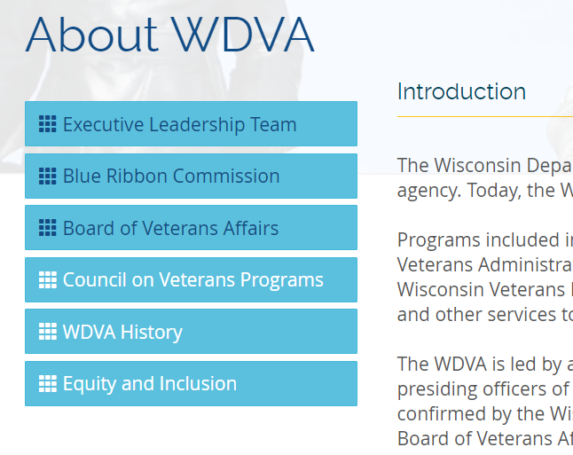
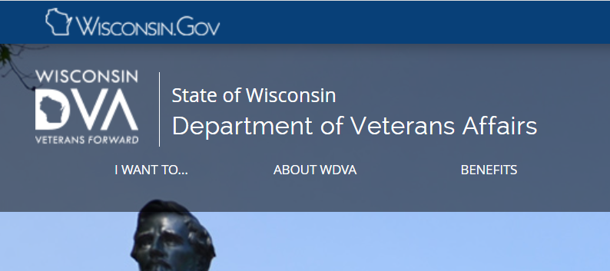
Commission Website
dva.wi.gov/Pages/aboutWdva/BlueRibbonCommission.aspx

Slide 10
Ethics Overview for Commission Members

Slide 11
Protecting Public Access to Information
Key Provisions from Wis. Stat. SS. 19.32 to 19.35
Subject to limited exceptions, the public “has a right to inspect any record.”
A record is any material on which information or data is recorded, except for:
“Materials that are purely the personal property of the custodian and have no relation to his or her office.”
Notes and drafts for personal use.
Unsolicited list-serve and other general public communications.
Duplicates of records retained elsewhere.

Slide 12
Protecting Public Access to Information
Effect on Attached commissions
All communications and materials you send to or from or receive for this Commission must be preserved, emails too.
You need to retain any records that:
You prepare, send or receive in connection with your status as a commission member (emails/letters/mailings), and
Are not notes, drafts, or generalized list-serve emails, and
Were received by you related to your role on the commission.

Slide 13
Protecting Public Access to Government
Key Provisions from Wis. Stat. SS. 19.82 to 19.98
“Every meeting of a governmental body shall be preceded by public notice” and – except for certain topics – must take place in open session.
The open-meetings law applies whenever:
Members meet for the purpose of engaging in board-related business, and
The number of members present is sufficient to determine the governmental body’s course of action.

Slide 14
Where to Go When Questions Arise
Wisconsin Ethics Commission
Web resource: www.ethics.wi.gov
608.266.8123
ethics@wi.gov

Slide 15
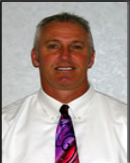
Overview and History of the Veterans Trust Fund
Jim Parker
Administrator of the Division of Enterprise Services, WDVA
Notes:
Nick Hillman, Director, Student Success Through Applied Research (SSTAR) Lab, UW-Madison
Dr. Nicholas Hillman is an Associate Professor in the University of Wisconsin-Madison’s School of Education. His research focuses on the intersection of college access and finance, namely in the areas of student financial aid and state higher education finance. His research employs statistical analysis of large datasets and has been published in the field’s top academic journals. Dr. Hillman’s research has been recognized for excellence by the Association for the Study of Higher Education and the National Association of Student Financial Aid Administrators. He is the director of the Student Success Through Applied Research (SSTAR) Lab and is a faculty affiliate in the Center for Financial Security, La Follette School of Public Affairs, and Institute for Research on Poverty.
Welcome, Dr. Hillman!

Slide 16
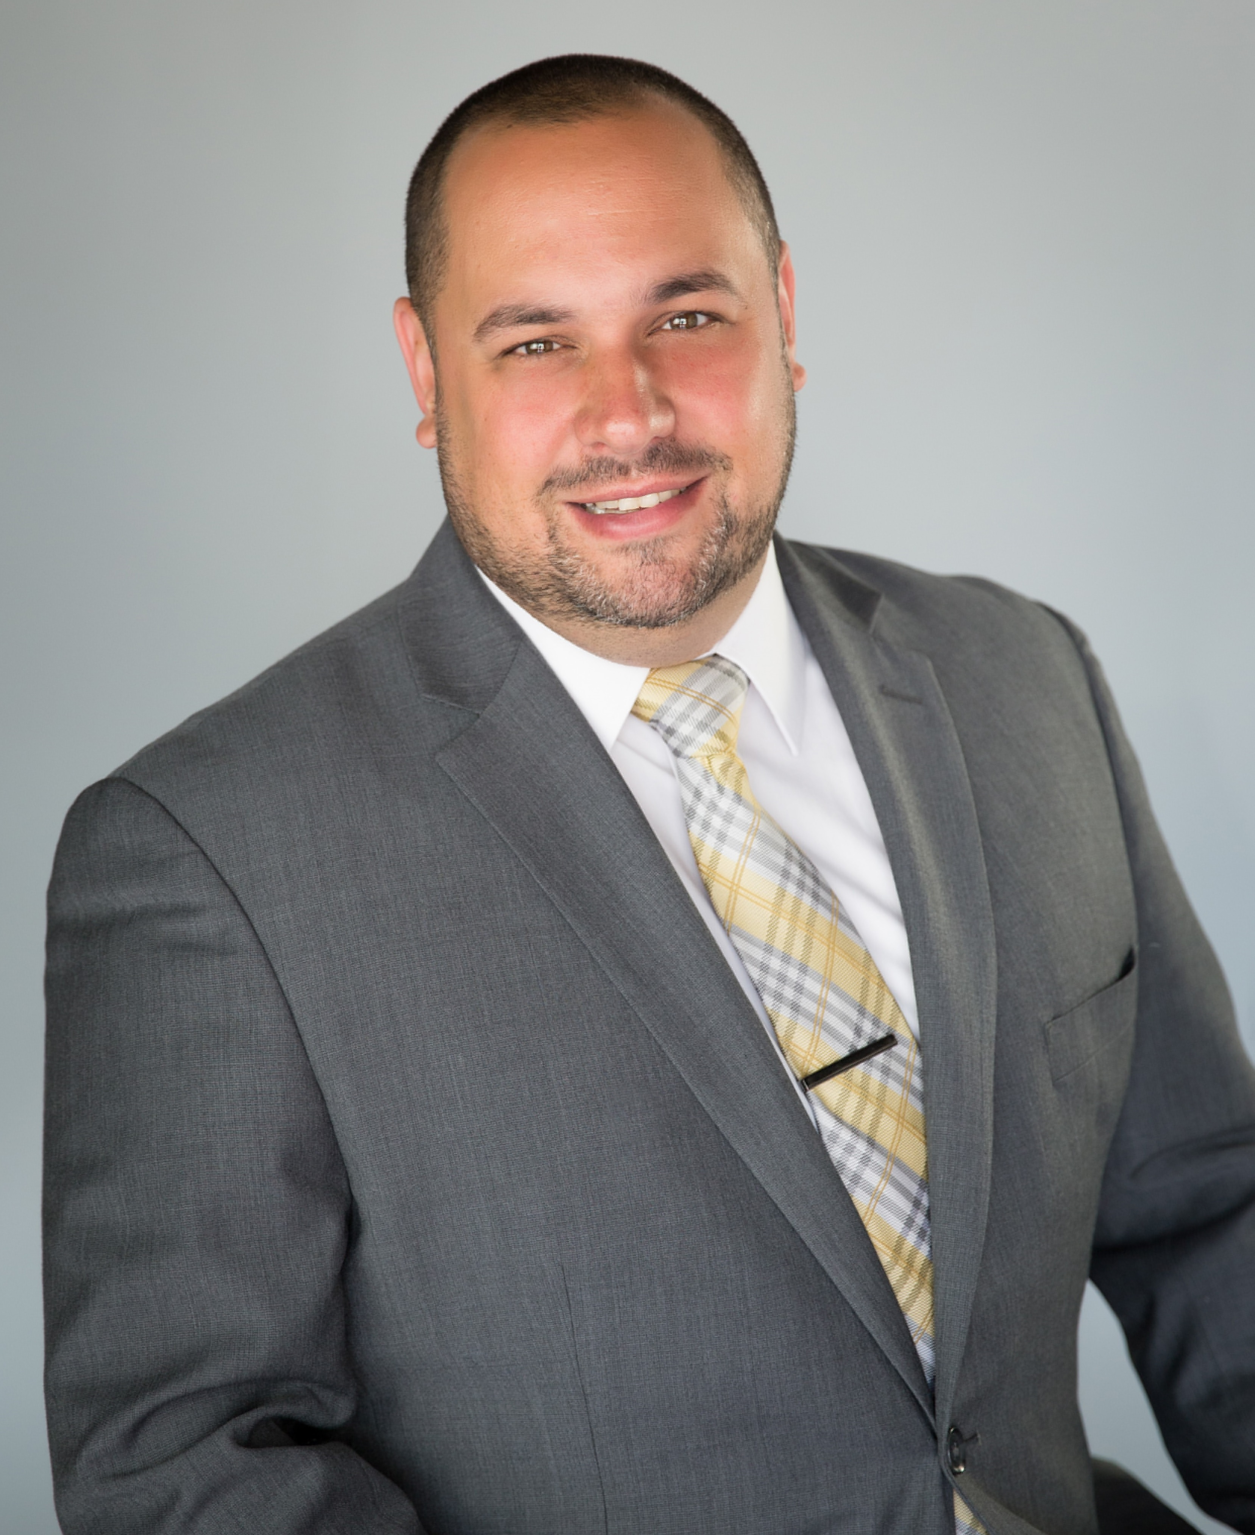
VTF-Funded Programs, Services and Benefits: Overview and Testimonials
Donald Placidi
Division Administrator of the Division of Veterans Benefits, WDVA
Notes:
Nick Hillman, Director, Student Success Through Applied Research (SSTAR) Lab, UW-Madison
Dr. Nicholas Hillman is an Associate Professor in the University of Wisconsin-Madison’s School of Education. His research focuses on the intersection of college access and finance, namely in the areas of student financial aid and state higher education finance. His research employs statistical analysis of large datasets and has been published in the field’s top academic journals. Dr. Hillman’s research has been recognized for excellence by the Association for the Study of Higher Education and the National Association of Student Financial Aid Administrators. He is the director of the Student Success Through Applied Research (SSTAR) Lab and is a faculty affiliate in the Center for Financial Security, La Follette School of Public Affairs, and Institute for Research on Poverty.
Welcome, Dr. Hillman!

Slide 17
Testimonial 1 Fannie Xie
Veteran business Owner of Uni Uni Appleton, First Authentic Bubble Tea Shop in Appleton

Slide 18
Testimonial 2 James Larson
U.S. Army veteran, former client of the Veteran outreach and recovery program (VORP) and the Veterans Housing and Recovery Program (VHRP)

Slide 19
Testimonial 3 Quentin Hatfield
Executive director of the Wisconsin veterans network (Vetsnet)

Slide 20
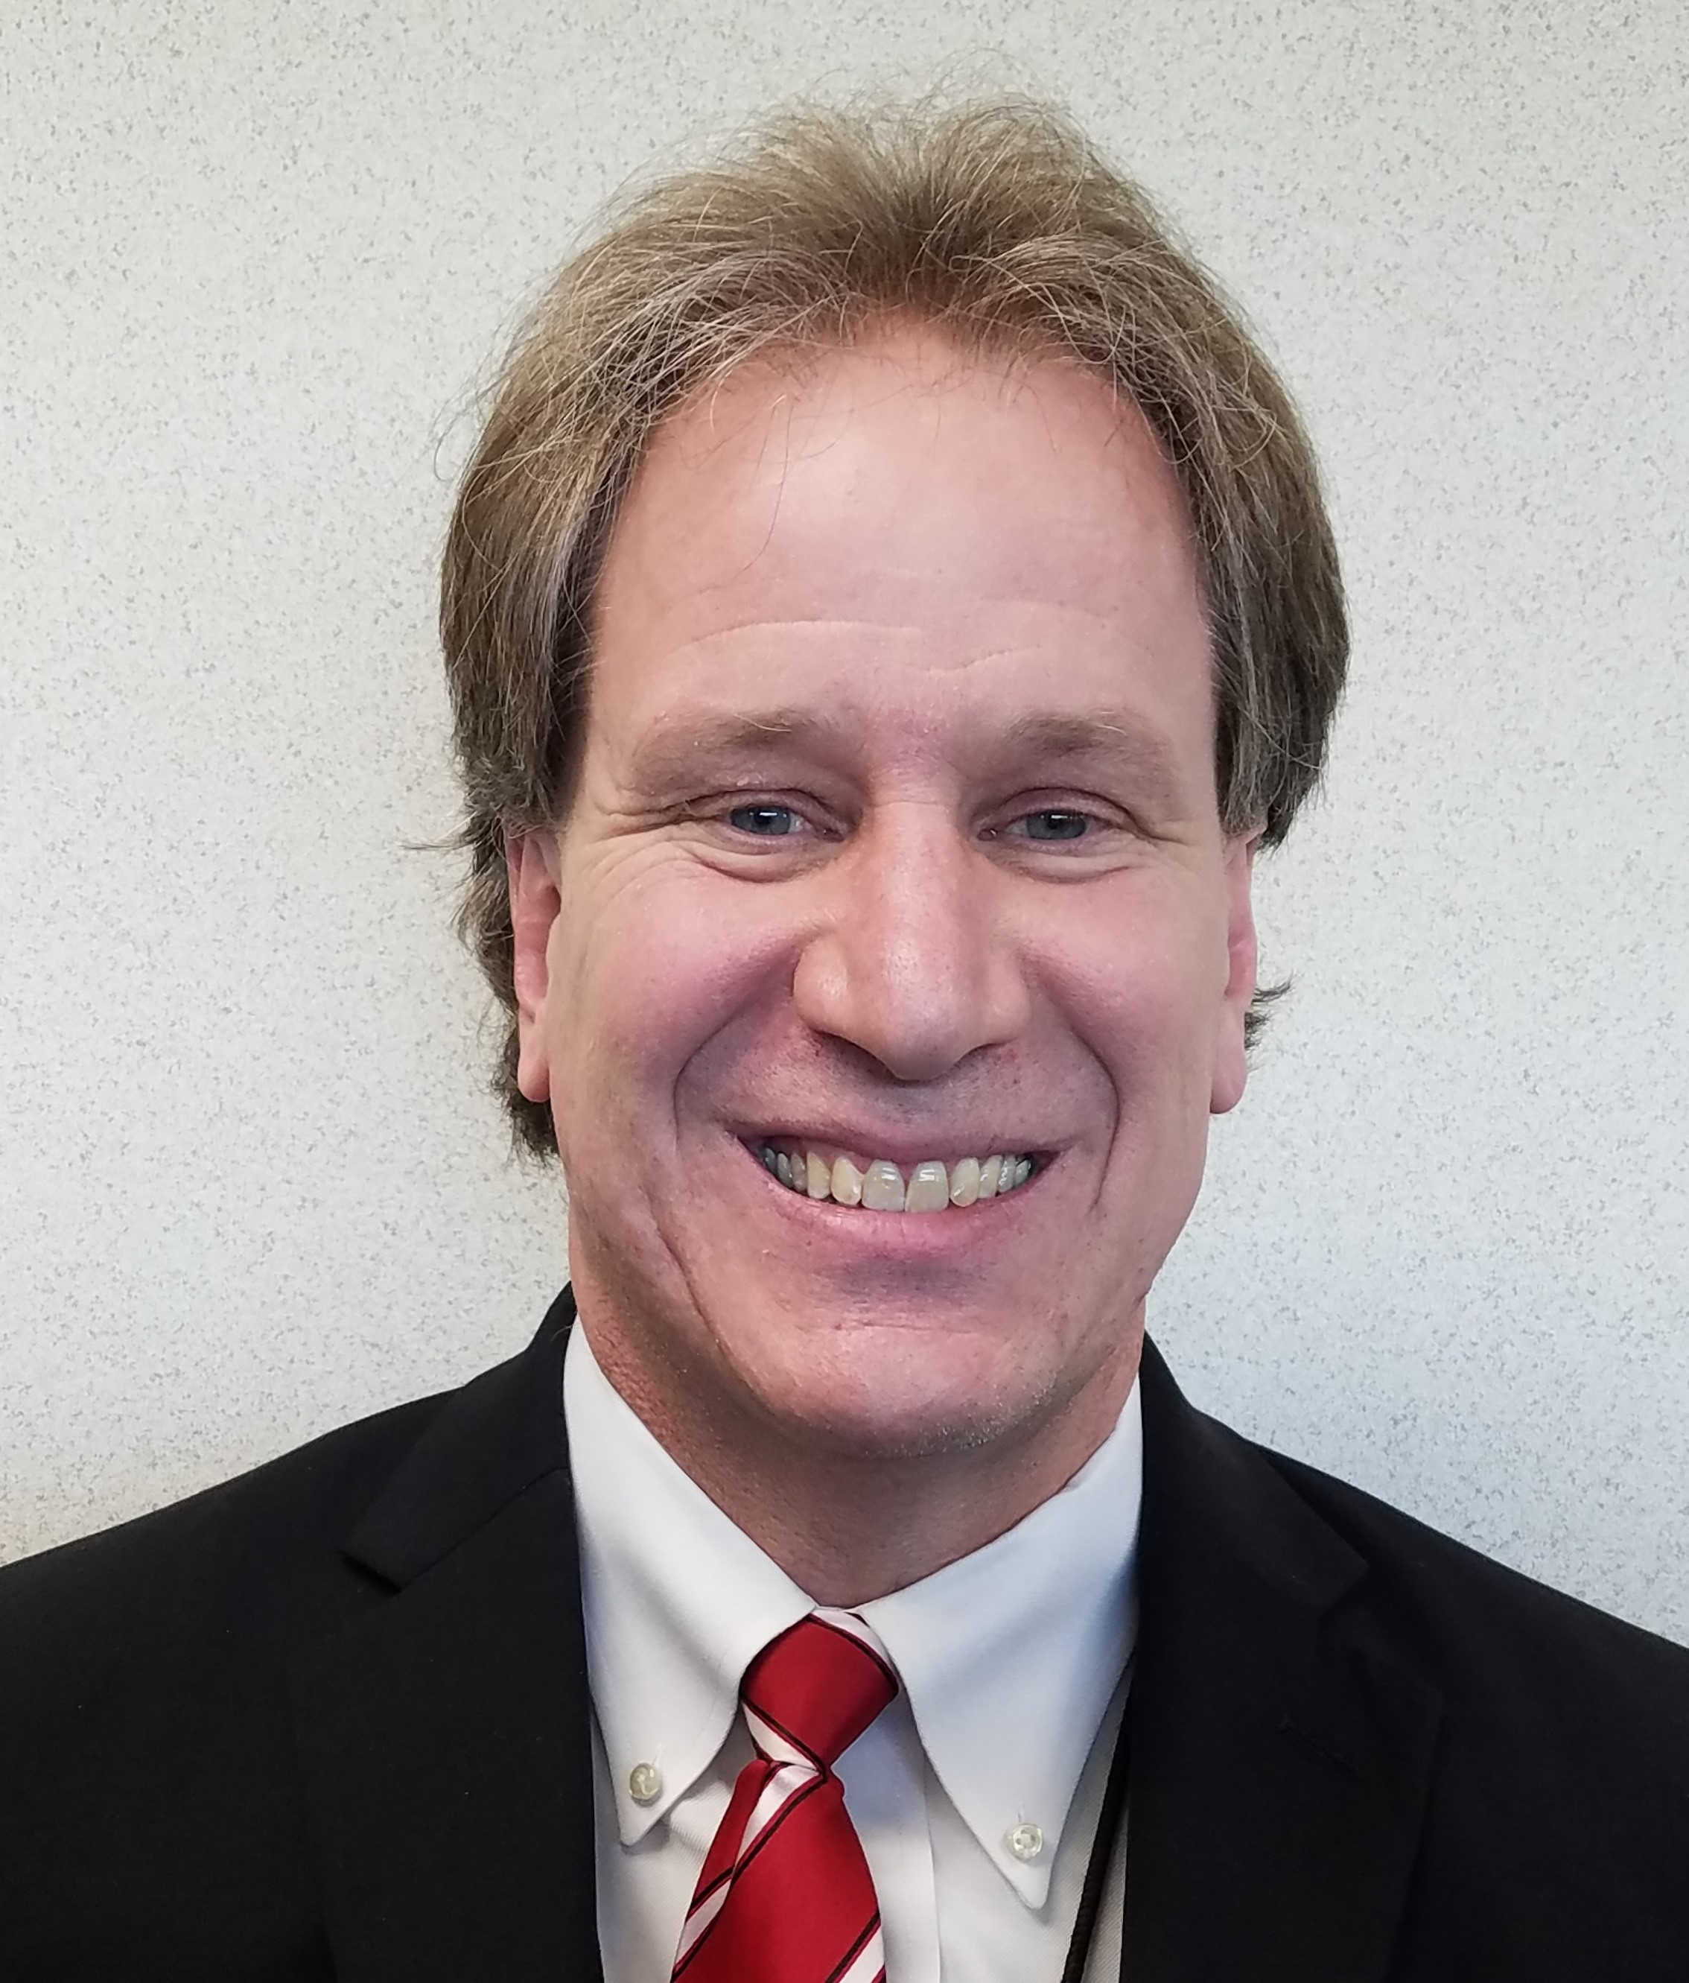
Funding Mechanisms
Brian Pahnke
State budget director, DOA
Notes:
Nick Hillman, Director, Student Success Through Applied Research (SSTAR) Lab, UW-Madison
Dr. Nicholas Hillman is an Associate Professor in the University of Wisconsin-Madison’s School of Education. His research focuses on the intersection of college access and finance, namely in the areas of student financial aid and state higher education finance. His research employs statistical analysis of large datasets and has been published in the field’s top academic journals. Dr. Hillman’s research has been recognized for excellence by the Association for the Study of Higher Education and the National Association of Student Financial Aid Administrators. He is the director of the Student Success Through Applied Research (SSTAR) Lab and is a faculty affiliate in the Center for Financial Security, La Follette School of Public Affairs, and Institute for Research on Poverty.
Welcome, Dr. Hillman!

Slide 21
Next Steps
Meeting #2:
May 24, 2020
9:00 a.m. – 11:00 a.m.
Zoom
Contact: VeteranOpportunity@wisconsin.gov
Feedback: Michelle.Reinen@wisconsin.gov
Notes:
Thank everyone for their attendance and participation today.
Extra thanks to our presenters and speakers for sharing their expertise, experience and time.
Remind members the next meeting is scheduled and will be held via WebEx.
If Task Force members have any needs or questions, they can reach out via email to: StudentDebtTaskForce@dfi.wisconsin.gov (Marko, Cheryl)
Any comments related to today’s meeting related to logistics – please reach out to me Michelle Reinen (facilitator).

Slide 22
Thank you!

Slide 23
Question for the Group What programs are you aware of, or familiar with, that we have not yet discussed? (These could be happening within your organization, community, or other states.)
Notes:
Facilitated Discussion Questions:
Instructions: Each of these questions should be discussed in relation to being a student, and then the pre- and post-borrowing process.
Based on what you have heard from the various presenters, what solutions do you believe could address the disparate impact student debt has on vulnerable communities? And why? (ex. Borrow Bill of Rights, Ombudsman, Licensure, etc.)
What programs are you aware of, or familiar with, that we have not yet discussed? These could be happening within your organization, community or other states.
What do you think is the most critical thing the Task Force could do to address the Student Debt crisis for Wisconsin borrowers?

